Slide 1

TEIS Referral
Data Analysis
Nashville Software School
Data Analytics | Cohort 7
Notes:
Introduction

Slide 2
Working Together: Getting Started
For simplicity and clarity, we are going to follow the order of the questions in the readme.
You will need to designate a speaker for the data that was found in your group.
We will need to know how many slides you will need for your portion of the presentation (per group/ question).
If requesting multiple slides, provide the order that you would like the slides to be in.
If you would like specific titles on your slides, please also provide that information. We will otherwise provide a simplified reiteration of the question that the slide will be answering.
EXAMPLE:
QUESTION :What is the rate of re-referral?
SLIDE TITLE : Re-referral Rate
** We will be posting a form to fill out/ gather this information for each group in the DDA7 Slack Channel.

Slide 3
Working Together: Getting Us the Info
Send all project info in the TEIS Project Slack thread within the DDA7 Channel.
When sending info/ charts etc, please make sure to list the question you are working on and slide title/ number if you have multiple.
Please send visuals and text as soon as it is completed in your group. If your question has multiple questions within it that you are answering, please send us each sub-question as you finish it so we can be building out the presentation as you continue to work.
Timeframe: our goal is to have all the visuals and text needed for the slides by the END OF DAY. We understand that may not be possible for all the questions, but please make sure to send us what you have that is completed so that we can continue to format and work through the layout.
EOD: If you are still finishing up visuals/ answering the questions by end of day, please communicate to us what you still have left to do so we can coordinate amf gae our work load for the morning.

Slide 4
Working Together: Colors & Content
Colors: Blue/ Green Font: Default in Python: Open Sans (varieties)
Visuals: Please provide some sort of table or chart for each question (questions can be grouped into a single visual).
Save visuals as a PNG. Trends/ Takeaways: Provide statements of trends in bullet point format. Each team can provide multiple statements of trends as reflected in their data. There is no limit, but so to not be overwhelming to the client, try to limit to 2-3 per group.

Slide 5
Working Together: Next Steps
1.) Fill out the group form posted in the TEIS Slack Thread in the DDA7 Channel ASAP.
QUESTION: (This value should be 1-5 as it corresponds to the ReadMe)
SPEAKER:
NUMBER OF SLIDES:
TITLES/ORDER OF SLIDES:
2.) Send us any visuals or info for your slides as it become available.
3.) Create bullet points of the main takeaways from your findings. These should be in a simplified, statement format that identifies specific trends.

Slide 6
Question 1
Notes:
First question

Slide 7
Re-Referral Rate By Year

Slide 8
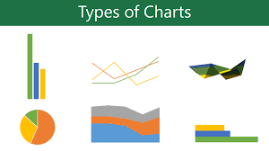
Re-Referral Rate By POE

Slide 9
Re-Referral Rate By POE

Slide 10
Question 2
Notes:
Second Question

Slide 11
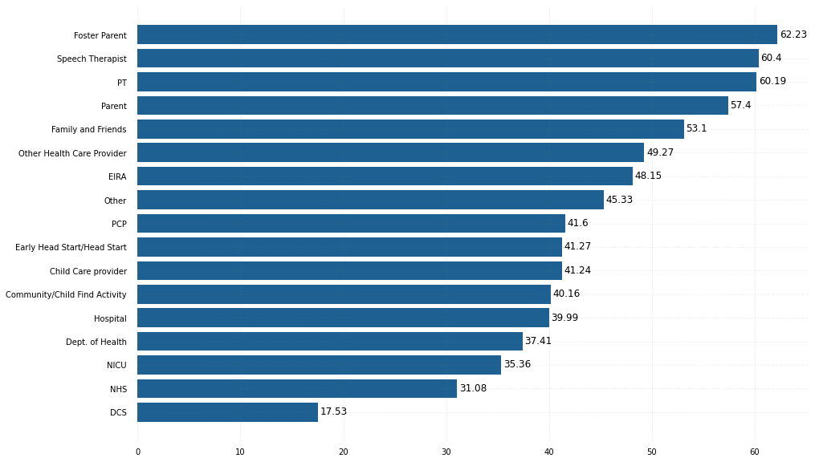
Successful Referral Percentages

Slide 12
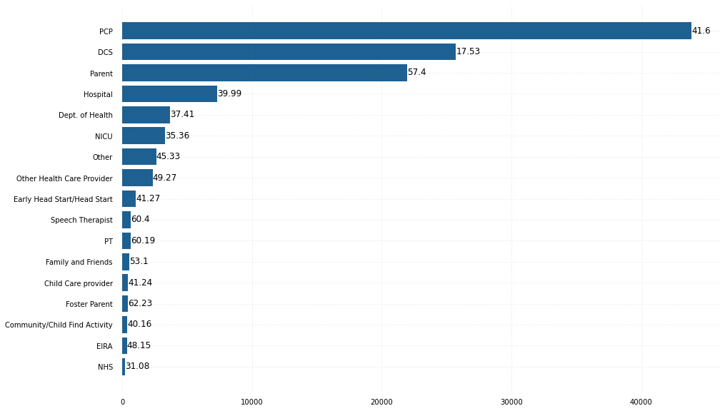
Total Referrals with Success Percentage

Slide 13
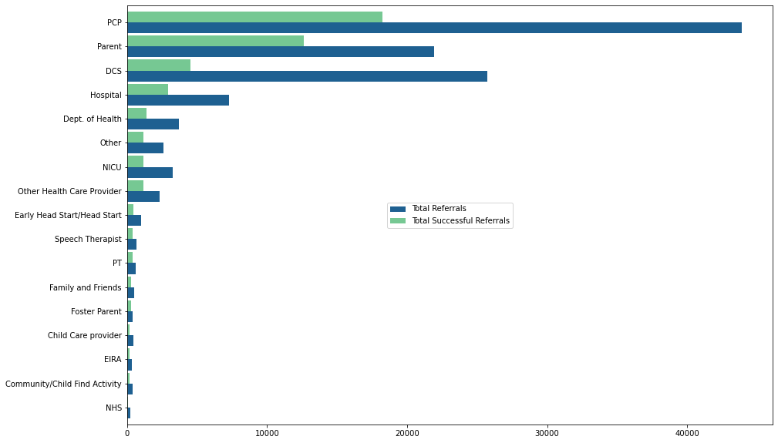
Total Referrals vs Total Successful Referrals

Slide 14
What did we learn?
Out of 24 referral source types, only 17 have made 100 or more referrals since 2016
5 most successful referral source types: Foster Parent – 62.23%
Speech Therapist – 60.4%
Physical Therapist – 60.19%
Parent – 57.4%
Family & Friends – 53.1%
5 least successful referral source types: DCS – 17.53%
NHS – 31.08% NICU – 35.36% Dept of Health – 37.41%
Hospital – 39.99%
PCP is the biggest referral source, but ranks 9 out 17 for successful referral percentage at 41.6%
DCS is the second biggest referral source, but ranks 17 out 17 for successful referral percentage at 17.53%
Parent is the third biggest referral source, but ranks 4 out of 17 for successful referral percentage at 57.4%
Resource types who work more closely with a child have better successful referral percentages
Institutions which typically have transient relationships with a child are the least successful referral sources
Volume of referrals does not equal success of referrals, measured by creation of an IFSP

Slide 15
Question 3
Notes:
Third Question

Slide 20
Question 4
Notes:
Fourth question

Slide 24
Question 5
Notes:
Last question

Slide 28
Key Takeaways
Please bullet point out 1-3 of the key trends you saw in your specific question.
These will serve as a good reference point for TEIS in reviewing the key trends identified for each question.
Notes:
Summary/ Recommendations

